Slide 1
"Hey @grandkids, Like Me On Facebook!" Estate Planning for Digital Assets
Marve Ann M. Alaimo, Esq.
Estate Planning Council of Lee County
April 21, 2016

Slide 3
What are “Digital Assets”?
Text, images, multimedia, information or personal property stored in a digital format whether stored on a server, computer or other electronic device which currently exists or may exist as technology develops and regardless of the ownership of the physical device upon which the digital asset is stored. Includes words, characters, codes, etc.

Slide 4
Types of Digital Assets
Documents
Photos
Music
Videos
Spreadsheets
Tax records and returns
PowerPoint presentations
e-mails
text messages

Slide 5
Types of Digital Assets
e-books
Video & gaming accounts
Social media
Apps
Financial accounts
Business accounts/records
Domain names and blogs
Loyalty program benefits
Virtual property (avatars, etc.)

Slide 6
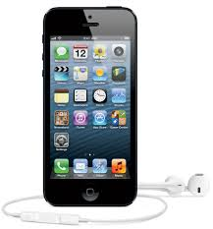
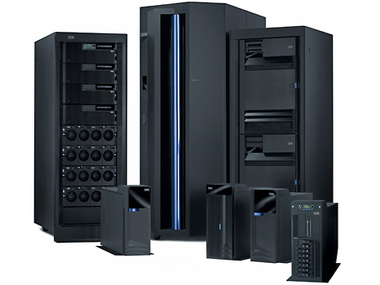
Where Are Your Digital Assets?
Computers
Servers
Smart Phones
The “Cloud”

Slide 7
Why Plan For Digital Assets
To give access to your family and fiduciaries upon death or disability
To prevent identity theft
To prevent financial loss and preserve valuable digital assets
To preserve memories and stories
To protect secrets

Slide 8
Roadblocks to Access
Security and encryption
Informational and technological obsolescence
Limitations of applicable laws
Custodial terms of agreement that may block or restrict fiduciary access
Licensed assets (versus owned assets)

Slide 9
Planning Ideas
Prepare inventories of your digital assets, including means for access
Convert digital assets to tangible assets or move digital assets to accessible offline locations for better access, preservation
Where custodian agreements allow it, give custodian account handling instructions

Slide 10
Planning Ideas
If allowed, specify third parties who will have authorized access
Authorize your attorney-in-fact or executor to access digital assets
Designate a special “digital fiduciary” knowledgeable to gather and protect your digital assets
Transfer ownership of valuable digital assets to an entity

Slide 11
Provider Policies
Google will work with fiduciaries to close accounts and may provide content. They do not provide login or passwords.
Google Inactive Account Manager. Allows users to share certain account data or to notify others if the account has been inactive after a period of time
Facebook allows you to specify that your account be deleted or memorialized upon death. Someone can also submit a request to remove the account of a family member who is deceased or disabled.
Facebook Legacy Contact. Allows you to name someone to look after your account after it’s memorialized or to download the content you shared.

Slide 12
Digital Afterlife Companies
Online safe deposit boxes that holds passwords, files and instructions for authorized persons who can access your digital assets.

Slide 13
Digital Afterlife Companies
Posthumous e-mail services that delivers message to designated recipients after your death.
Photo, documents, video and social media content preservation

Slide 14
Uniform Fiduciary Access to Digital Assets Act (2015)
A uniform law to extend traditional powers of a fiduciary to manage tangible personal property to include the management of digital assets like computer files, web domains and virtual currency but restricting fiduciary access to electronic communications like e-mail, texts and social media content unless the original user consents to access in estate planning documents or other records.

Slide 15
UFADAA
As of 2015, UFADAA has been enacted in:
Colorado
Florida
Idaho
Indiana
Michigan
Oregon
Tennessee
Washington
Wisconsin
Wyoming

Slide 16
Florida Fiduciary Access to Digital Assets Act
New Florida Statutes, Chapter 740
Effective for fiduciaries acting on or after July 1, 2016 for Florida residents
Does not apply to employer digital assets used by an employee in the ordinary course of the employer’s business
Allows attorneys in fact, guardians, trustees and personal representatives access to digital assets and specifies the requirements for obtaining access
Differentiates electronic communications from other types of digital assets

Slide 17
FFADAA
Offline digital assets will be managed like tangible personal property
Hard drives
flash drives
content on compact discs
Users can now designate who has access to online digital assets
Pursuant to the custodian’s own procedure
Via estate planning documents, such as wills, trusts and powers of attorney

Slide 18
FFADAA
Custodians of online assets have the discretion to choose how they disclose assets and can charge a fee for disclosure
Full access
Partial access needed to fulfill fiduciary duties
Copies of records that would have been accessible by the user
A user or fiduciary can request partial disclosure but if onerous the custodian can refuse disclosure and request a court order authorizing partial or no disclosure or seeking in camera review.

Slide 19
FFADAA: Electronic Communications
If a user authorizes it or a court allows it a fiduciary can access the content of e-communications provided the custodian gets proof of fiduciary’s authorization and, if requested by the custodian, information identifying the user’s account. Custodian can also request a specific court order.
Without user authorization or court order, the fiduciary can only get a catalog of electronic communications (except when expressly prohibited by the user or the court)

Slide 20
FFADAA: Other Digital Assets
Without user authorization or court order, the fiduciary can get other digital assets (other than content of electronic communications) upon providing proof of authorization and, if the custodian requests, information identifying the user’s account.

Slide 21
FFADAA: Trusts
The Act acknowledges that digital assets can be owned by trusts and sets forth procedures for access by trustees
authorization for access will be subject to court or trust provisions
original acquiring trustees have full access
upon providing proof of authority, successor trustees can get
full access if the trust specifically authorizes the successor trustee to get electronic communications
catalog of communications if the trust is silent.

Slide 22
FFADAA: Special Certifications
Fiduciaries that are not court appointed must give special certifications
Agents have to certify under penalties of perjury that the power of attorney that authorizes them is still in full force and effect
Successor trustees have to provide certified copies of trusts or statutory certification of the trust, and must certify under penalties of perjury their status as successor and that the trust is in full force and effect

Slide 23
FFADAA: Fiduciary Duties
Fiduciary duties of care, loyalty and confidentiality apply.
Fiduciary’s access is limited by the scope of their duties and authorizing documents
Fiduciaries can request account termination
Except as provided by the Act, terms of service still apply and so other applicable laws (including intellectual property laws and federal laws criminalizing certain digital activity)

Slide 24
FFADA: Custodian Complaince
Custodians must comply no later than 60 days after receiving information required by the Act for disclosure
Court orders can be obtained to enforce compliance
If the custodian receives a request for disclosure, the custodian can notify the user (e.g. principal under POA)
Custodians can deny requests if they are aware of lawful access to the account following request
Custodians can still request court orders to confirm authority for access
Custodians have immunity for acting in good faith

